Slide 1
Principles of Building Planning
Prepared by: Goyani Jalpesh R.
Tajani kayul
Khunt Nirav s.
GUIDANCE BY:
Khorasiya sandeep (Asst.prof)

Slide 2
Principles of planning
Aspect
Prospect
Privacy
Groping
Romminess
Flexibility
Furniture requirements
Circulation
Lighting
Elegance
Economy
Sanitation

Slide 3
Aspect
Aspect refers to the planned arrangement of the doors and windows of the external walls to get sunlight,breeze and a good view of the scenery outside.
Types of room | Suggested aspect
Drawing room | South,SE
Bed Room | West,SW
Dining room | South
Kitchen | East
Verandah | West,SW

Slide 5
Prospect
A building is said to have prospect when it presents a good and pleasing appearance when seen from outside.
It is used to mean the external views as seen from certain rooms of the building.
It also includes the concealment of some undesirable views in a given outlook.

Slide 6
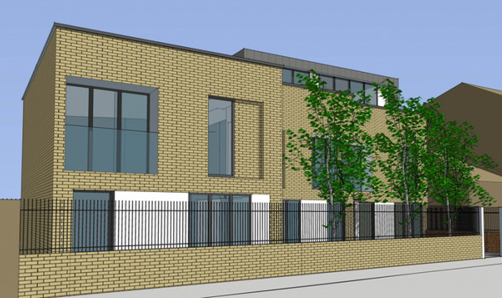

Slide 7
Privacy
For residential building planning privacy is important consideration. There should be privacy from one room to another room and also from neighbour building and public building and public building and streets.
Privacy is necessary in the bedroom, bathroom,wc and urinals.

Slide 9
Grouping
Grouping refers to easy communication and utility of various room .kitchen and dining room should be close to each other.
Store room should be adjacent to kitchen. WC and urinals should be far away from the kitchen .

Slide 11
Roominess
Roominess refers to an arrngement of getting yhe maximum advantage from the minimum or limeted dimensions of a room.
The space must be utilised economically. Make the room rectanguler .
Ceiling height and breadth ratio may be 1.20 to 1.50 for bulilding planning.

Slide 13
Flexibility
The planning of the building should be prepared by keeping in mind the future requirement.
Expansion should be possible economicaily without major altertions in planning.
Planning should be such that with minor adjustments , it becomes possible to satisfy needs when the occasion arises.

Slide 14
Furniture requirement
During building planning the sizes of furniture to be required for functional utility of the rooms should be considered.
The size of the rooms should be decided by considering easy accomodation required.
Bed room size should accomdat bed ,cupbored, side table, Dressing table.

Slide 15
Circulation
Circulation refers to providing throgh passages between rooms in a bulding.
It is necessary to permit horizontal circulation throgh passages, corridors and lobbies and vertical circulation through staircases,lifts, and ramps in bulding .
Passage should be provied along

Slide 16
Lighting
Natural and artifical lighting is provided in bulding , planning. By proper venilation sunlight can given good lighting.
By using various electrical appliences artifical lighting is provided.
Glaer should be avoided.

Slide 17
Elegance
Elegance refers to the planning of elevation and layout of the plan to give an impressive appearance to the bulding.
The proper of elevation width, height, location of door and windows, materials employed in construction of exterior walls etc. create elegance is asthetics of bulding.

Slide 18
Economy
Bulding planning should be carried out in the financial limit of the cilent.
An engineer should know in advance, client intends to spend for the bulding and according material of consturaion finshing items stage constucion should be suggested.
By estimation proposed amount should be followed to avoid miserble faliure of bulding construction project.

Slide 19
sanitation
Provision for cleanliness , lighting and ventilation in sanitary units avoid growth of bacteria and spread of disease condition.
The ventilators in bath w.c permit sunlight and air circulation to maintain hygenic conditon the kitchen sholud have glazed tiles dedo

